Slide 1
Classification, Reserve & RQO determination of water resources in the Mvoti to Umzimkulu Water Management Area
DRAFT WATER RESOURCE CLASSES FOR THE SOUTHERN, CENTRAL & NORTHERN CLUSTER IUAs
Delana Louw
Rivers for Africa
16 Sept 2015
PRESENTATION TITLE
Presented by:
Name Surname
Directorate
Date

Slide 2
WHAT IS A TARGET ECOLOGICAL CATEGORY?
Each IUA is allocated a Water Resource Class and a catchment configuration.
Catchment Configuration: Consist of biophysical nodes (which can be estuaries) and its Ecological Categories.
These Ecological Categories, could be the PES, the REC of any other category and is referred to as the Target Ecological Category (TEC).
As a starting point, the TEC will strive to = the REC.
But classification is a balance between protection and use and therefore the TEC may be different than the REC depending on the implications of meeting the REC.

Slide 3
APPROACH FOR RECOMMENDING THE CATCHMENT CONFIGURATION
Steps to achieve the Target Ecological Categories:
PES & REC evaluated and interventions required to achieve the REC identified.
Evaluate implications of interventions.
Identify best compromise/balance scenarios.
Compare ecological consequences to REC.
Considering all consequences, derive a Target Ecological Category (focus on immediately applicable).
Provide implications of the TEC for future development and use of the system.
Present for stakeholder input (today)

Slide 4
APPROACH TO RECOMMEND THE CATCHMENT CONFIGURATION
Scenarios to be implemented in the medium to long term:
Indications will be provided on whether these Scenarios meet the TEC or not.
This information can guide the definition of an optimised scenario or recommendations on alternative options.
Future socio-economic implications may also require the gazetted immediate applicable TEC to be revised in the future.
In summary: Medium to long term scenarios and evaluation are used to identify the implications of the TEC and Class for future development and use of the resource.

Slide 5
WATER RESOURCE CLASS AND CATCHMENT CONFIGURATION
NORTHERN CLUSTERS

Slide 6
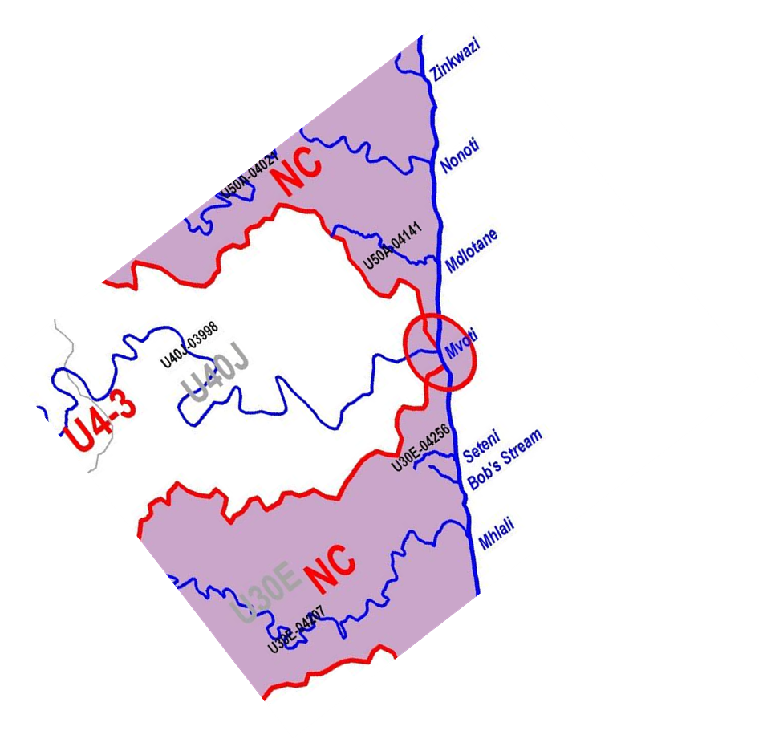
DRAFT WRC: NC IUA – CLASS III
PES = REC = TEC
No implications for any user.
TEC
REC
PES
TEC=REC (PES requires improvement)
Mdlotane: Improve catchment water quality, restore estuarine habitat.
Nonoti
Bob’s Stream
Zinkwazi
Mdlotane
Seteni
Mvoti
TEC lies below the PES
Mhlali: Increased waste water as infrastructure already developed. Will drop TEC below PES
Mhlali
D C B A

Slide 7
DRAFT WRC: NC IUA – CLASS III
TEC improves PES but does not meet REC
Zinkwazi: Improve wq & restore estuarine habitat. Improve →B. REC an A/B but socio-economic implications major.
Mvoti: Reduce catchment nutrient input. Remove sugarcane from EFZ. Can accommodate new dam (Sc 42) & limited increases in WW, but options to keep mouth open must be investigated.
Nonoti
Bob’s Stream
Zinkwazi
Mdlotane
Seteni
Mvoti
Mhlali
D C B A

Slide 8
WRC & TEC IMPLICATIONS
WRC III and its catchment configuration will result in:
TEC = REC at 4 of the 7 estuaries, i.e., REC is met at 4 estuaries.
TEC is an improvement of the PES at 2 of the 7 estuaries (one to a B TEC), i.e. the REC is partially met.
TEC falls below the PES at one estuary.
Mhlali
Nonoti
Mvoti
Bob’s Stream
Zinkwazi
Mdlotane
Seteni

Slide 9
WRC & TEC implications
Non-flow related measures must be applied to achieve the TEC at the Mvoti, Zinkwazi and Mdlotane estuaries
The WRC & TEC allow for increased waste water discharges in the short term to a specific point. (EG Sc C and D) in the Nonoti and Mvoti. Then alternative measures for additional waste will be required.
Note: For the Mvoti a combination of interventions must be investigated that will ensure the TEC is achieved when waste water is increased prior to future dam development

Slide 10
WRC & TEC implications
In Summary:
The WRC associated with the REC would be a Class II. This could only be met by
Removing new infrastructure at Mhlali
Applying all interventions at the Mvoti and removing SAPPI effluent or applying very costly techniques to remove the high organic content.
The above two estuaries are the largest and carry a high weight. As such, to comply to a Class II requirements, they would have to change from a C/D and/or D to at least a C.
The socio-economic cost of this would be large (least desirable socio-economic option)

Slide 11
DRAFT WRC & CATCHMENT CONFIGURATION
CENTRAL CLUSTER IUA

Slide 12
DRAFT WRC: CC IUA – CLASS III
TEC=REC.
Umhlanga: Implement pumping scheme to comply to existing EWR uMngeni: Implement approved EWR, various non flow measures
Amanzimtoti: Improve catchment water quality & riparian habitat
Zone in Durban Bay: Improve storm water management, reduce fishing, estuarine habitat in upper reaches
TEC
Tongati
PES
REC
Mdloti
Umhlanga
uMngeni
Durban Bay
Sipingo
Mbokodweni
Amanzimtoti
FE D C B A
Notes:
Known fish kills: Amazintoti (Aug 2015), Isipingo (July 2014)

Slide 13
DRAFT WRC: CC IUA – CLASS III
TEC = PES but below REC
Tongati: Will drop to below PES in short term, but could increase to state between PES and REC in long term.
Mdloti: Reuse water and increase waste water to the level that improves estuary.
Sipingo: Maintain the F as limited restoration potential.
TEC
Tongati
PES
REC
Mdloti
Umhlanga
uMngeni
Durban Bay
Sipingo
EF TEC
Mbokodweni: Interventions too difficult (costly) to improve E to D. EF TEC – must not become health hazard etc
Mbokodweni
Amanzimtoti
FE D C B A
Notes:
Known fish kills: Amazintoti (Aug 2015), Isipingo (July 2014)

Slide 14
DRAFT WRC: CC IUA – CLASS III
EF TEC
Interventions too difficult (costly) to improve E to D. EF TEC – must not become health hazard etc
Little Amanz
Lovu
Msimbazi
PES = REC = TEC
Ngagane: No implications to user.
Umgababa
Ngagane
uMkhomazi
TEC=REC.
Improve water quality, partial restoration riparian habitat, reduce fishing pressure (Mahlongwa)
Mahlongwane
Mahlongwa
FE D C B A
Notes:
Known fish kills: Amazintoti (Aug 2015), Isipingo (July 2014)

Slide 15
DRAFT WRC: CC IUA – CLASS III
TEC improves PES but does not meet REC
Lovu, Umgababa: Improve water quality, partially restore estuarine habitat.
uMkhomazi: Restore veg, remove sandmining, curb recreation, reduce cast netting in relevant reaches. Can accommodate Dam & Sc 21
Little Amanz
Lovu
Msimbazi
Umgababa
Ngagane
uMkhomazi
TEC = PES but below REC
Msimbazi: Improvement from B to an A would require removing existing development from the catchment
Mahlongwane
Mahlongwa
FE D C B A
Notes:
Known fish kills: Amazintoti (Aug 2015), Isipingo (July 2014)

Slide 16
WRC & TEC IMPLICATIONS CC IUA
WRC III and its catchment configuration will result in:
TEC = REC at 6 of the 16 estuaries, i.e., REC is met at 6 estuaries.
TEC is an improvement of the PES at 4 i.e. the REC is partially met.
TEC for 10 estuaries are an improvement of the PES.
TEC = PES but not REC at 4 estuaries.
TEC falls within the EF zone in two estuaries.
Tongati
Little Amanz
Durban Bay
Amanzimtoti
Mbokodweni
Sipingo
Msimbazi
Lovu
REC
Mahlongwa
Ngagane
TEC
Umgababa
uMkhomazi
Mahlongwan
PES
Mdloti
Umhlanga
uMngeni

Slide 17
WRC & TEC IMPLICATIONS
Note: Scenario C and D indicated as preferred scenarios at all estuaries except for uMdloti and Tongati. Scenario Gi (optimised for uMdloti and Tongati)
Non-flow related measures must be applied to achieve the TEC at the Umhlanga, uMngeni, Amansimtoti, Mahlongwana and Mhlongwa estuaries
EWR must be implemented at uMngeni and pumping scheme operated for Umhlanga
Mkomazi: No further waste into estuary. The proposed Smithfield Dam with appropriate operating rule will comply to the TEC.

Slide 18
WRC & TEC IMPLICATIONS
Little Amanzimtoti & Mbokodweni: Cost significant to be improved and low importance. Further waste can be accommodated, but estuaries must not become health hazards.
uMngeni: EWR must be implemented as well as other recommended interventions
Mdloti: Increased wastewater can be discharged in estuary towards the point where it starts degrading. In the short term, it the TEC may drop while Hazelmere Dam is being raised and fully utilised and the long term TEC achieved. (EG Sc Gi)
uThonghati: Re-use all wastewater (via Hazelmere) (long term – will meet TEC). In the short term, allow further discharge (E) category. (Eg, Sc Gi)

Slide 19
WRC & TEC implications
In Summary:
The WRC associated with the REC is also the recommended WRC of a III.
The WRC under current conditions do not comply to a WRC III due to the large areas in a category below a D.
The WRC of a III can be achieved through the recommendations summarised in previous slides and it is especially important that a large estuary such as the uMngeni achieves the TEC. If not, the WRC will not be met.

Slide 20
DRAFT WRC & CATCHMENT CONFIGURATION
SOUTHERN CLUSTER IUA

Slide 21
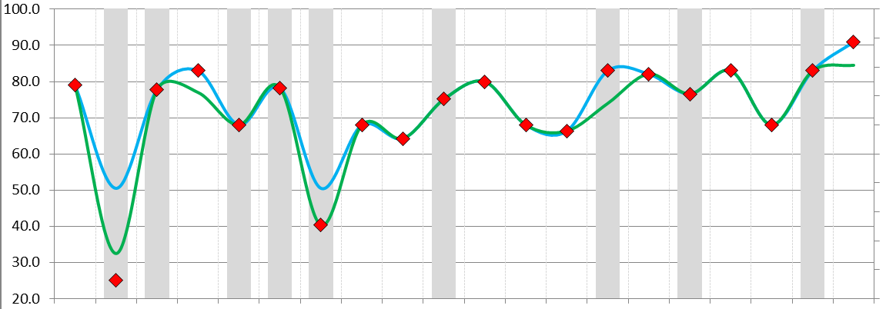
DRAFT WRC: SC.1 IUA – CLASS I
TEC=REC.
Mtamvuna: Restore riparian habitat, control fishing pressure.
Mpenjati: Sandmining, water quality, riparian habitat to be removed or improved
Zotsha: Improve estuarine riparian habitat, water quality
EF TEC
Mbango, Kongweni: Interventions too difficult (costly) to improve E to D. EF TEC – must not become health hazard etc
PES = REC = TEC
No implications to user.
Zotsha
Kongweni
Mbango
Ku-Boboyi
Mtamvuna
Boboyi
Mbizana
Kandandhlovu
Zolwane
Tongazi
Vungu
Mpenjati
Uvuzana
Kaba
Mzimkulu
Mhlangeni
Mvutshini
Sandlundlu
Bilanhlolo
Umhlangankulu

Slide 22
TEC IMPLICATIONS SC.1 IUA
WRC III and its catchment configuration will result in:
TEC = REC at 18 of the 20 estuaries, i.e., REC is met at 18 estuaries.
TEC in EF at 2 estuaries.
Zotsha
Kongweni
Mbango
Ku-Boboyi
Mtamvuna
Boboyi
Mbizana
Kandandhlovu
Zolwane
Tongazi
Vungu
Mpenjati
Uvuzana
Kaba
Mhlangeni
Mvutshini
Sandlundlu
Bilanhlolo
Umhlangankulu
Mzimkulu

Slide 23
TEC IMPLICATIONS SC.1 IUA
Note: Scenario C and D indicated as preferred scenarios (best balance)
Non-flow related measures must be applied to achieve the TEC at three estuaries
Zolwane, Tongazi: Scenarios that allow some increase in waste (eg Sc C and D) will meet the TEC
Mvutshini, Limited additional waste (as per Sc C) will meet the TEC
Vungu: Any increased wastewater must be diverted.
Kongweni & Mbango: Cost significant to be improved and low importance. Further waste can be accommodated, but estuaries must not become health hazards.
WRC is a Class I under the REC and PES situation

Slide 24
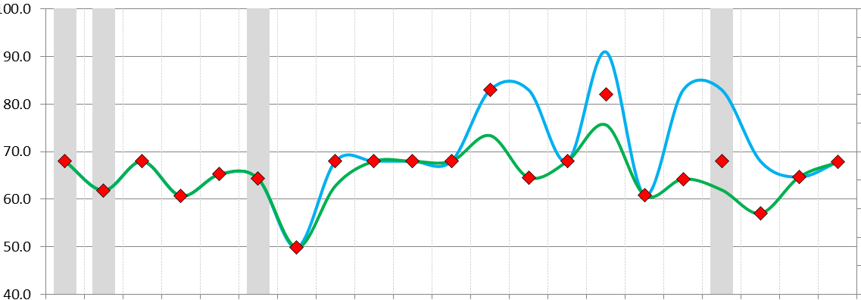
DRAFT WRC: SC.2 IUA – CLASS II
PES = REC = TEC: No implications to user.
TEC=REC: Fafa: Restore riparian habitat. Kwa-Makosi: Water quality, riparian habitat
TEC = PES but below REC: Mfazana, Domba, Intshambili: Needs restoration of baseflows (difficult). Socio-economic implications. Non-flow interventions required
TEC improves PES but does not meet REC: Koshwana: May require removal of waste. Too costly. Apply other non-flow interventions to improve
Mhlabatsjane: Improve Estuarine habitat to B – A/B (REC) too difficult.
Mpambanyoni
Mpambanyoni
Mtwalume
Mtwalume
Mhlangamkulu
Mkumbane
Mhlangamkulu
Mkumbane
Mzumbe
Nkomba
Mzumbe
Nkomba
Mtentweni
Mvuzi
Mtentweni
Mvuzi
Fafa
Fafa
Mzimayi
Mzimayi
Mzinto
Mzinto
Sezela
Sezela
Mdesingane
Mdesingane
Mhlabatsjane
Mnamfu
Mhlabatsjane
Mnamfu
Kwa-Makosi
Kwa-Makosi
Mhlungwa
Mhlungwa
Intshambili
Mfazazana
Intshambili
Mfazazana
Koshwana
Koshwana
Damba
Damba

Slide 25
TEC IMPLICATIONS SC.2 IUA
WRC II and its catchment configuration will result in:
TEC = REC at 17 of the 21 estuaries, i.e., REC is met at 17 estuaries.
TEC is an improvement of the PES at 2 estuaries i.e. the REC is partially met.
TEC = PES at 2 estuaries.
Mpambanyoni
Mtwalume
Mhlangamkulu
Nkomba
Mkumbane
Mzumbe
Mtentweni
Mvuzi
Fafa
Mzimayi
Mzinto
Sezela
Mdesingane
Mnamfu
Mhlabatsjane
Kwa-Makosi
Mhlungwa
Intshambili
Mfazazana
Koshwana
Damba

Slide 26
TEC IMPLICATIONS SC.2 IUA
Note: Scenario C and D indicated as preferred scenarios
Non-flow related measures must be applied to achieve the TEC at 6 estuaries
Sezela: Limited additional waster (as per Sc C) will meet the TEC
WRC is a Class II under the REC and PES situation

Slide 27
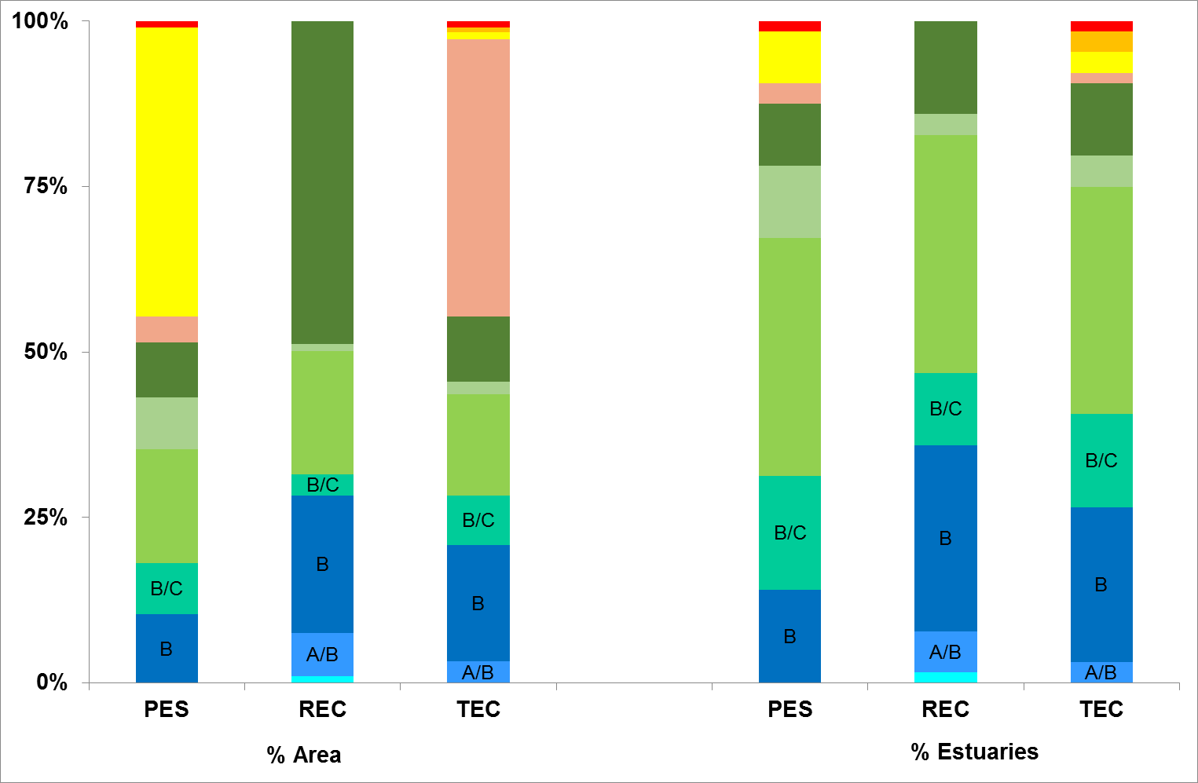
Summary of PES vs REC vs TEC at all estuaries
Indicative of improved condition in Durban Bay shallow water zone
=
PES:10% of area (14) in A or B Category
TEC: 21% (27 systems)

Slide 28
QUESTIONS FOR CLARIFICATION

